Slide 1

INTRODUCTION TO R
Danny Lumian, Ph.D.
Data Science Training Specialist
NIH Office of Data Science Strategy

Slide 2
Topics Covered
R platforms
R
R Studio
R Studio Cloud
R file types
R script
R markdown
R notebook
Basic R commands
R packages and built-in datasets
Data manipulation
Data visualization
Data import and export
Data analysis
Additional Analysis Notebooks

Slide 3

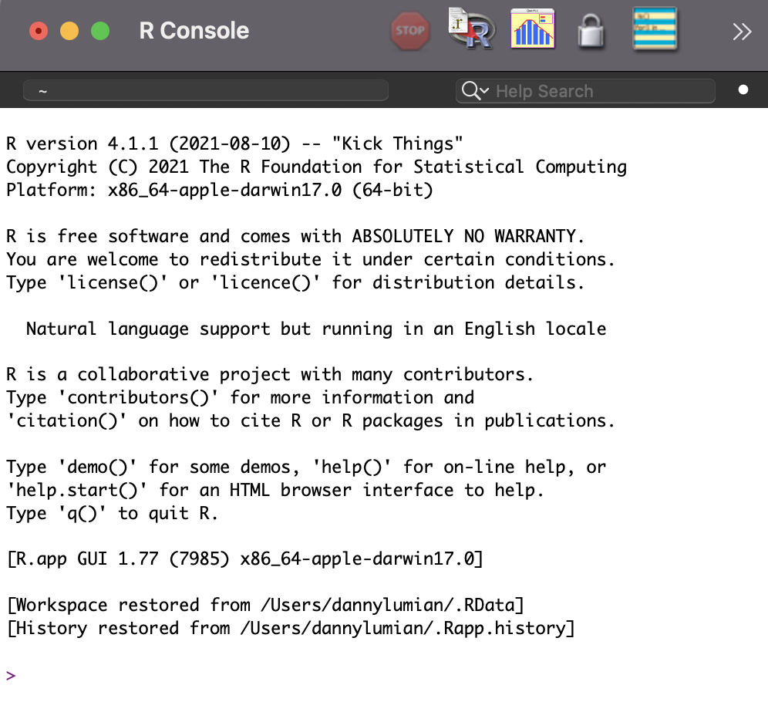
What is R?
A programming language and open-source software environment that can
Manipulate data
Visualize data
Perform statistics
Free and relatively easy to run in any environment
https://www.r-project.org/

Slide 4
What is R Studio
An integrated development environment (IDE) for R
Software that includes R, file explorer, graphics viewer, code notebook and more!
One stop shop for coding in R
https://rstudio.com/

Slide 5
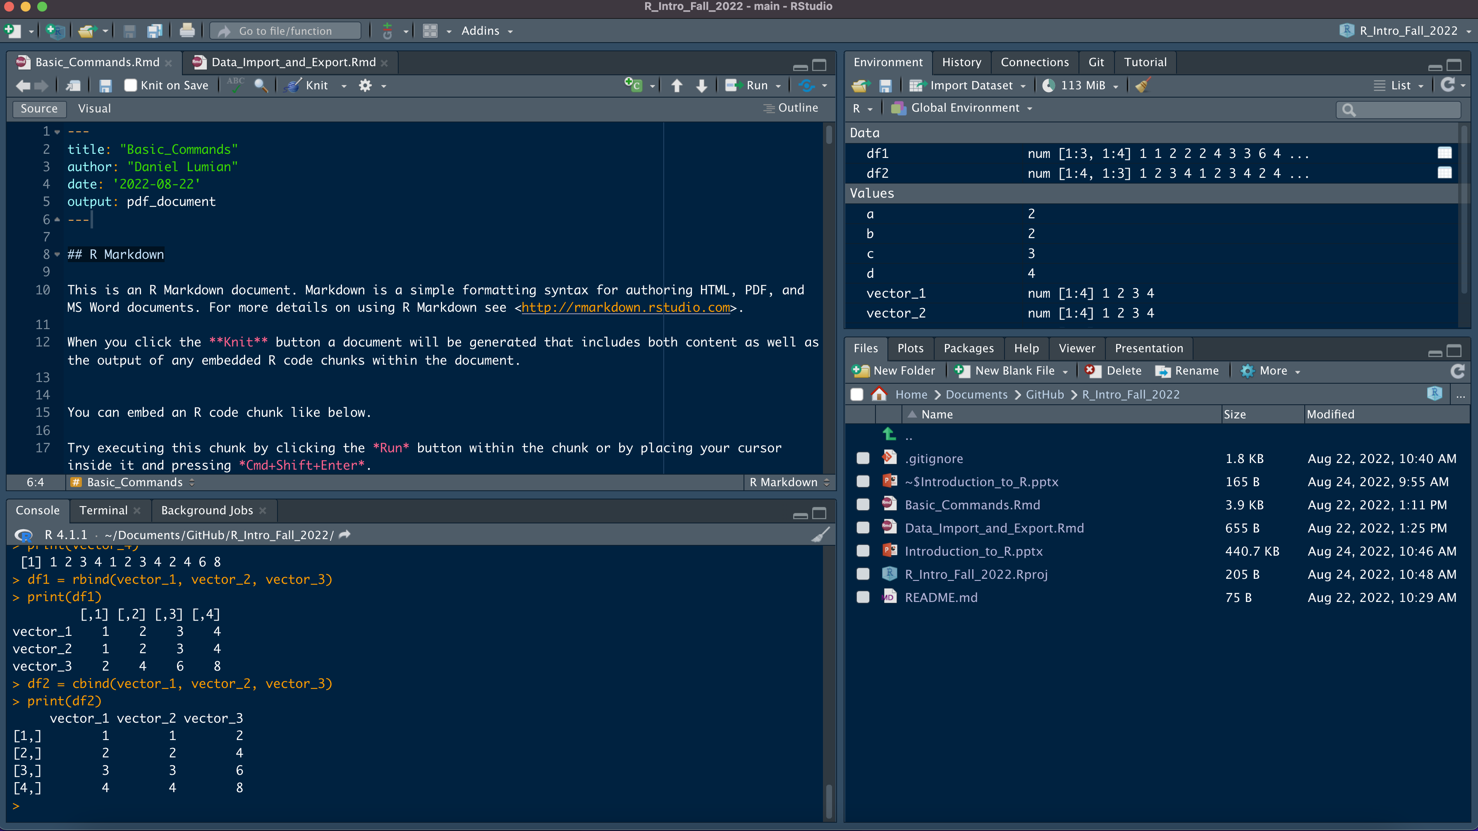
Notes:
4 main panes:
Top left-Script and notebook viewer
Top right-Environment. Variables and history
Bottom Left-Console/Terminal
Bottom right-file explorer, graphics pane, packages and help

Slide 6
What is R Studio Cloud
Cloud based version of R Studio
No need to download software
Can share projects easily for analysis and teaching
https://rstudio.cloud/

Slide 7
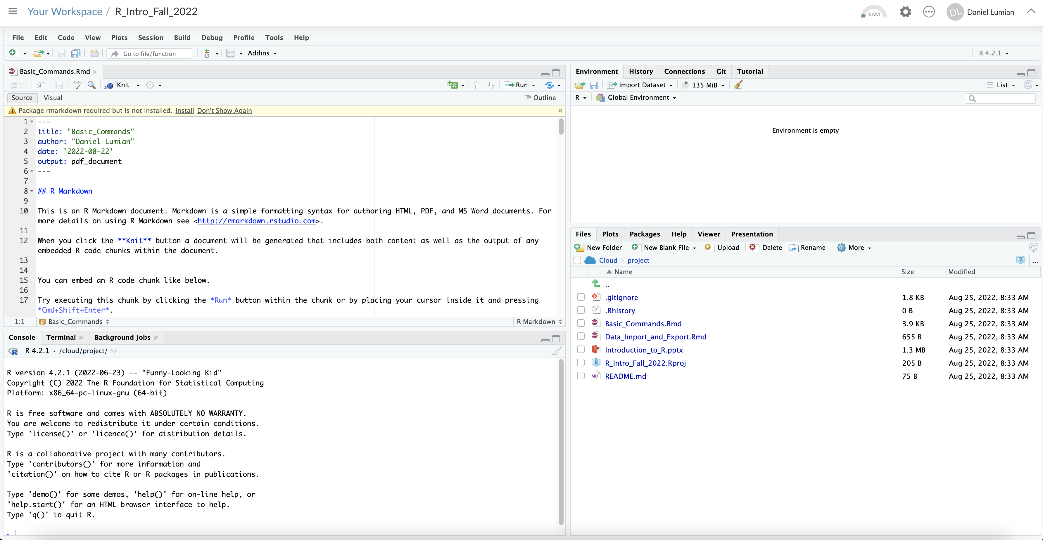
Notes:
Notice identical layout as R Studio

Slide 8
R File Types
R Script File
R Markdown and Notebook
Basic file for saving code
Can add comments using `#` symbol
Useful for testing code snippets and work that will not be shared
Sections can be selected and run
More advanced files that allow inclusion of markdown and style elements for documentation
Code lives in chunks within the file
Better for sharing and publishing code
Notebooks allow a preview feature, while Markdown files are knit
https://stackoverflow.com/questions/43820483/difference-between-r-markdown-and-r-notebook

Slide 9
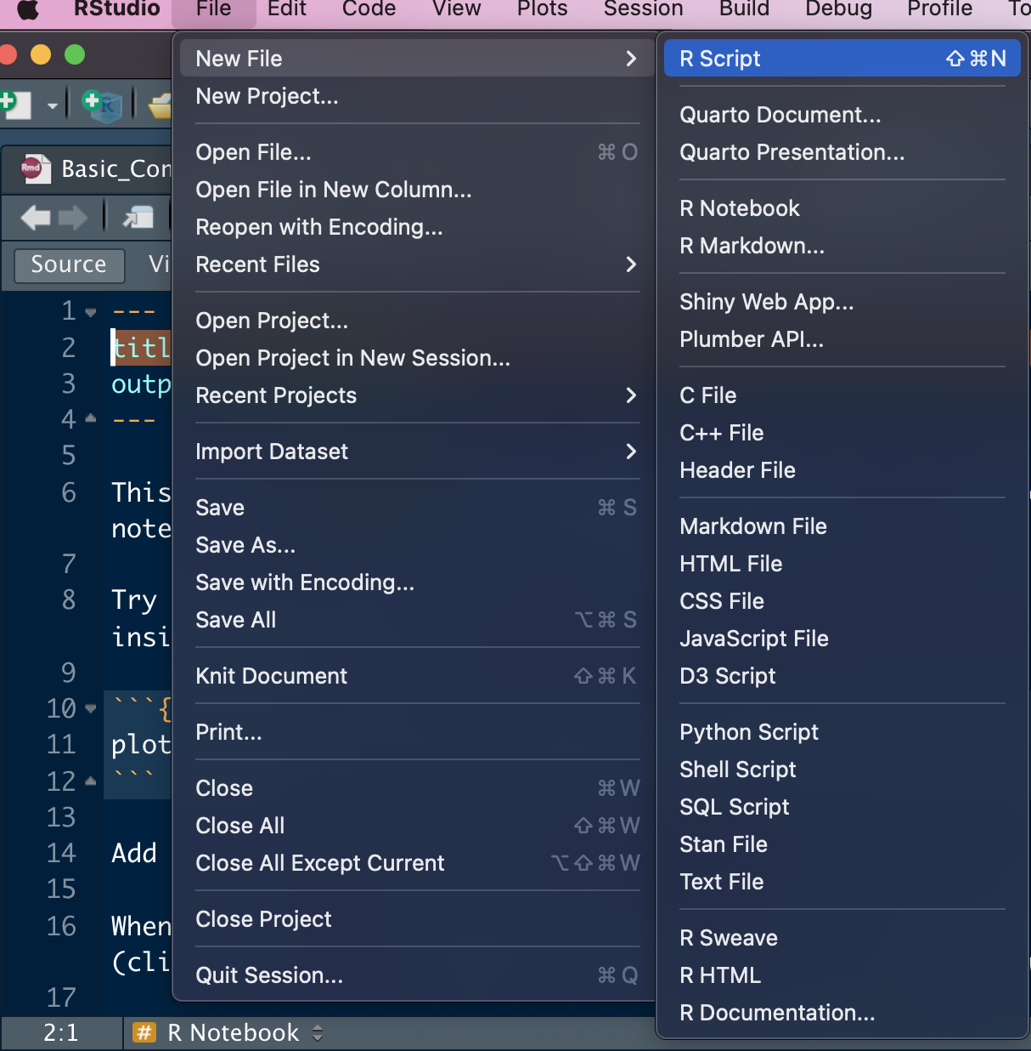
To open a new file, select File from the top panel
Select new file from the dropdown
Select appropriate file type
R script
R Notebook
R Markdown
To open an existing file, select File from the top panel
Select Open File…
To save a file, select File from the top panel
Select Save or Save as… and specify the save location
Notes:
Notice identical layout as R Studio

Slide 10
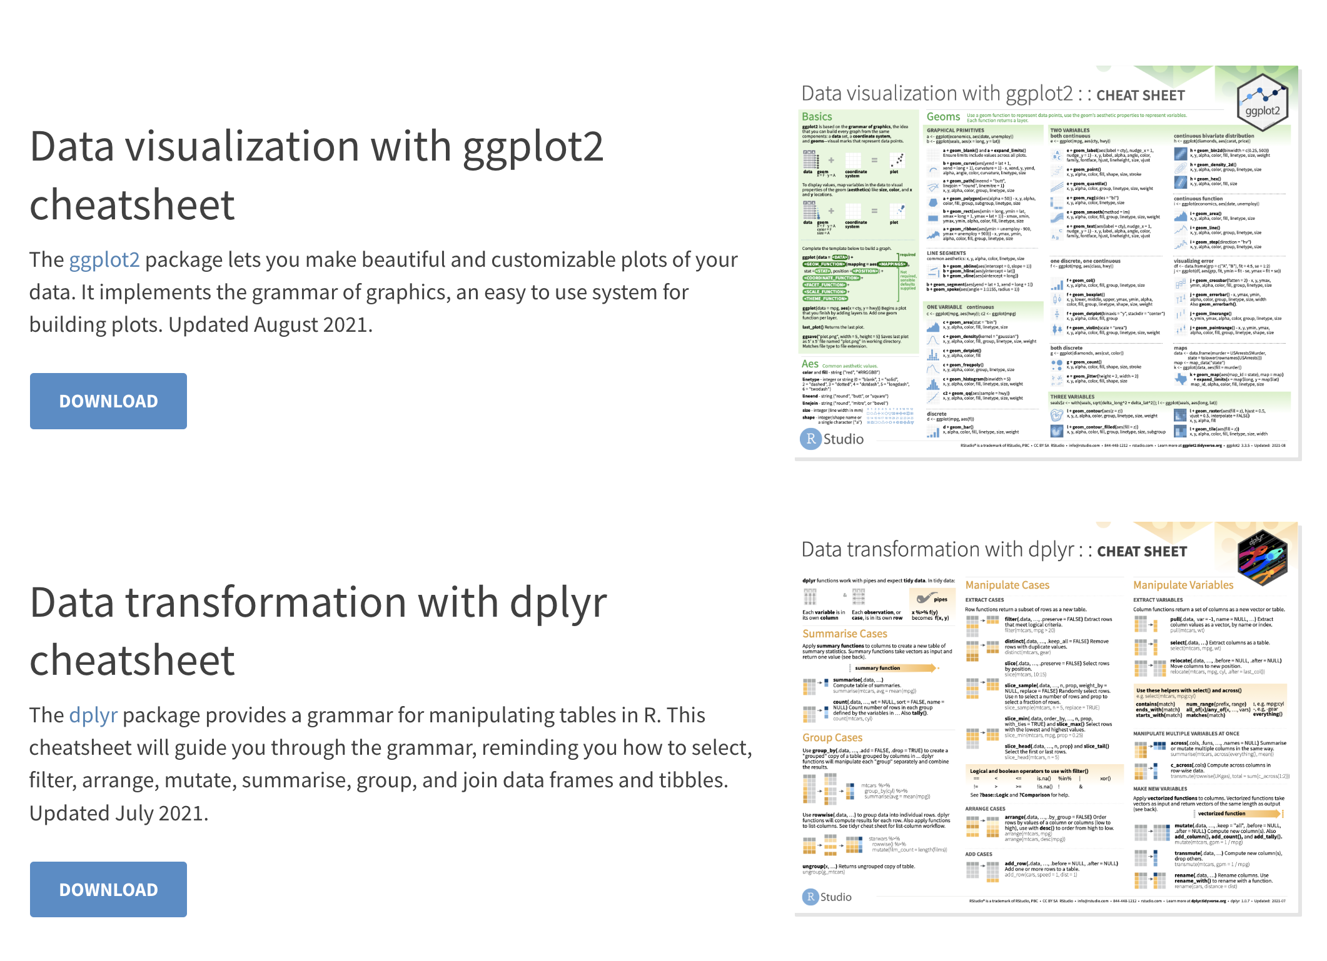
R Studio Cheat sheets: https://www.rstudio.com/resources/cheatsheets/

Slide 11
Let’s get started!
You may need to log in to your RStudio cloud account first
Go to https://rstudio.cloud/
Click log in
[Need to add r cloud studio link when ready]
First click on Save a permanent copy
https://github.com/dlumian/R_Intro_Fall_2022
Click on the new file icon
Select R script

Slide 12
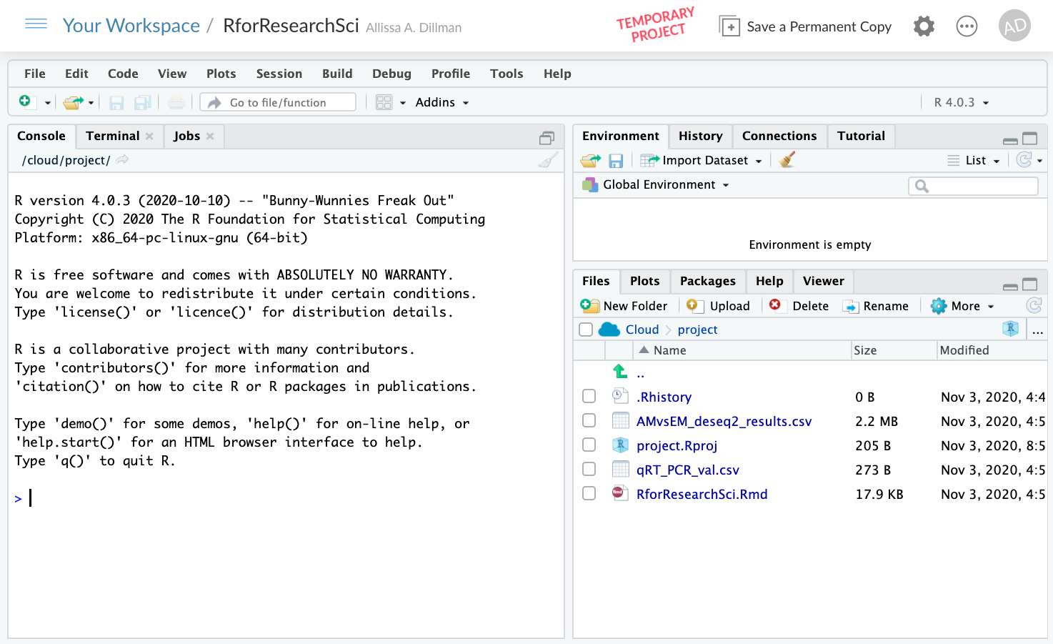
Notes:
Make slide for uploading data

Slide 13
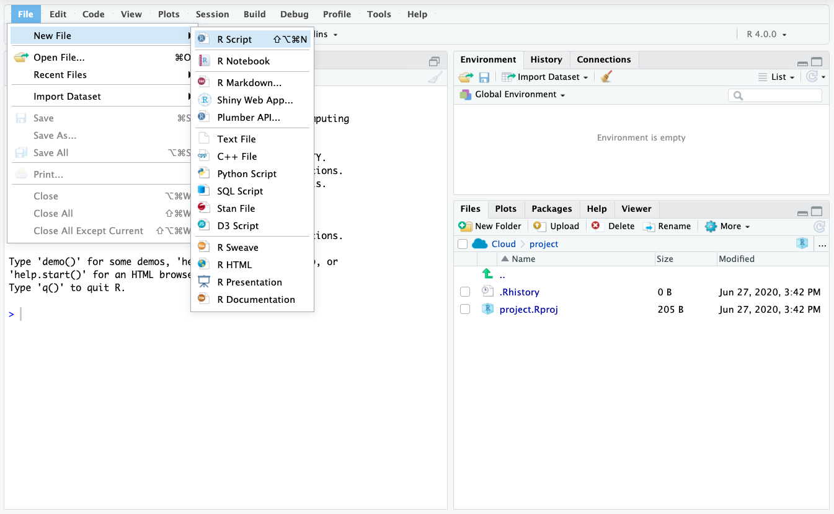
Write code here
Objects go here
Run code here
Written files go here
Notes:
Talk about the various windows console versus script file ect…

Slide 14
R is like a calculator
Enter the following
7+7
a=3
b=5
If I type a it will print out the contents of a which is 3
a+b
a-b
a*b
a/b
Notes:
We are running all these commands in the script file if we make a mistake we can edit and rerun. We can also make comments using # and it will not get in the way of the code.

Slide 15
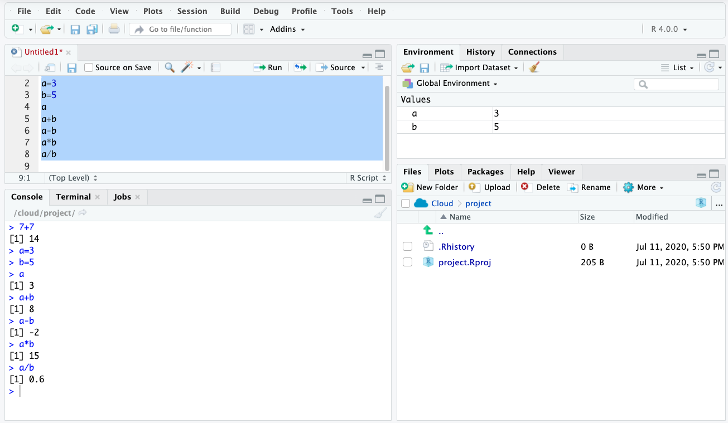
Highlight the section of code you want to run then click run
Temp memory objects

Slide 16
Make a Vector
Vectors are a data structure in R
-list of characters
-list of numbers
-must be same data type
Use the c() command to enter a bunch of numbers together
c stands for combine
Don’t know how to use it?
Type : ?c
Putting a `?` before a command or object will retrieve the help for that object
Notes:
C is short for combine

Slide 17
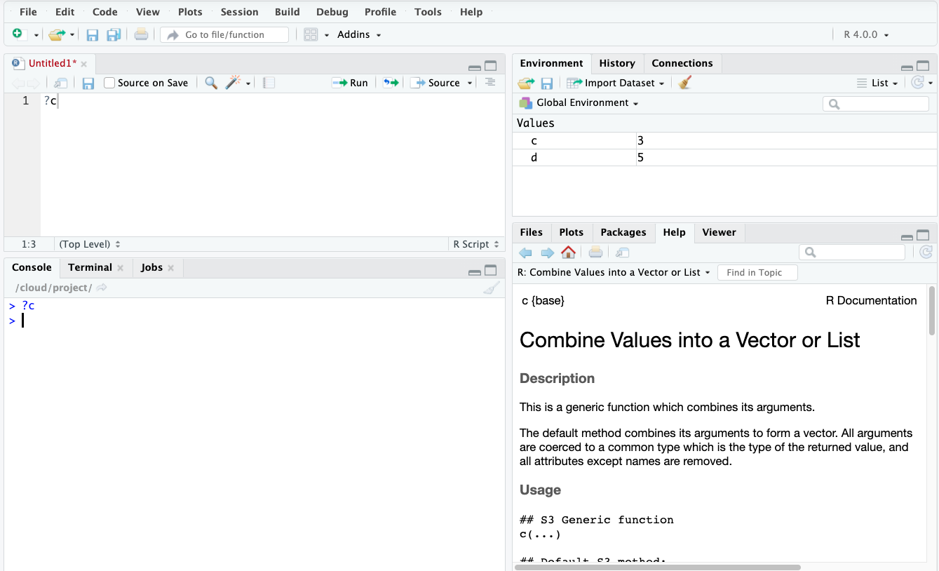

Slide 18
Typing ?
Typing “?” then the command name will give you help on the command name
Typically, examples you can try may be available at the bottom of the help information
Now let's use the c() command
c(5,6,7,8)
This just prints the output to the screen

Slide 19
Create an object
We can create an object for R to keep in its temporary memory
We will assign a name to the vector we used before
Type "d <-" in front of c(5,6,7,8) : d <- c(5,6,7,8)
We created an R object called “d” that is a vector of 5,6,7,8
Keyboard shortcut for <-
-PC: Alt and - at the same time
-Mac: option and - at the same time
Notes:
https://support.rstudio.com/hc/en-us/articles/200711853-Keyboard-Shortcuts

Slide 20
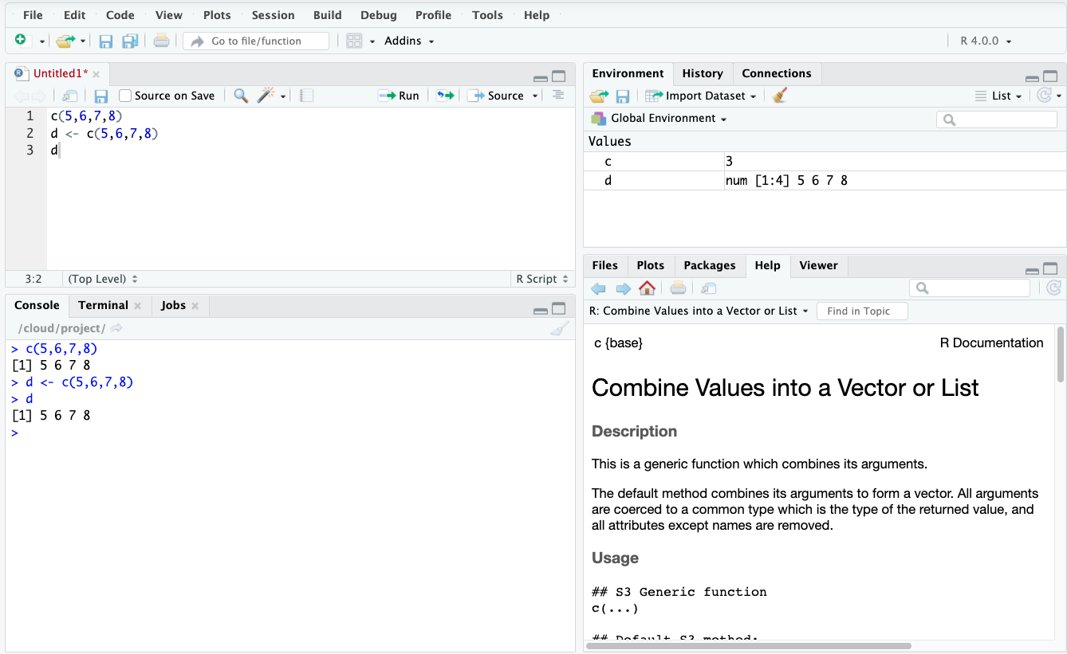

Slide 21
Make more vectors
e <- c(11,12,13,15)
f <- c(1,2,3,4)
g <- c(1,2,3,15)

Slide 22
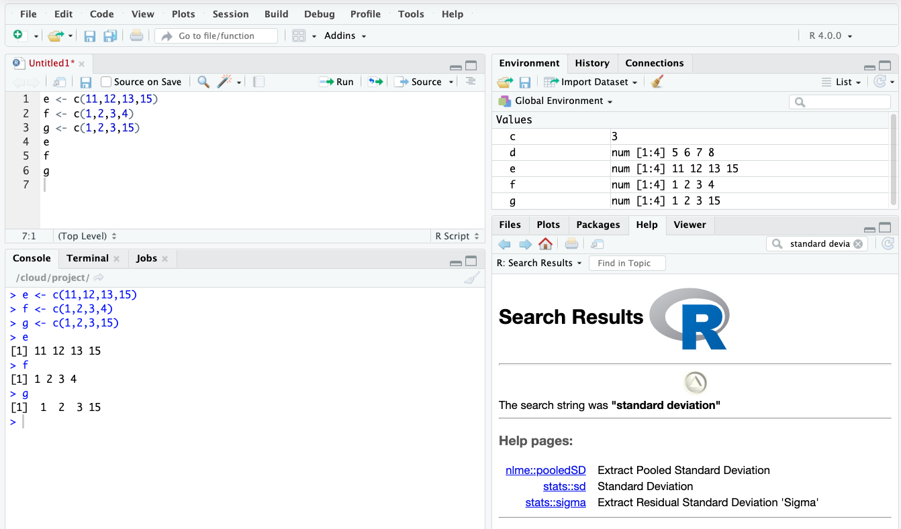

Slide 23
Perform Vector Calculations
d+e
d*e
f-g
f/g

Slide 24
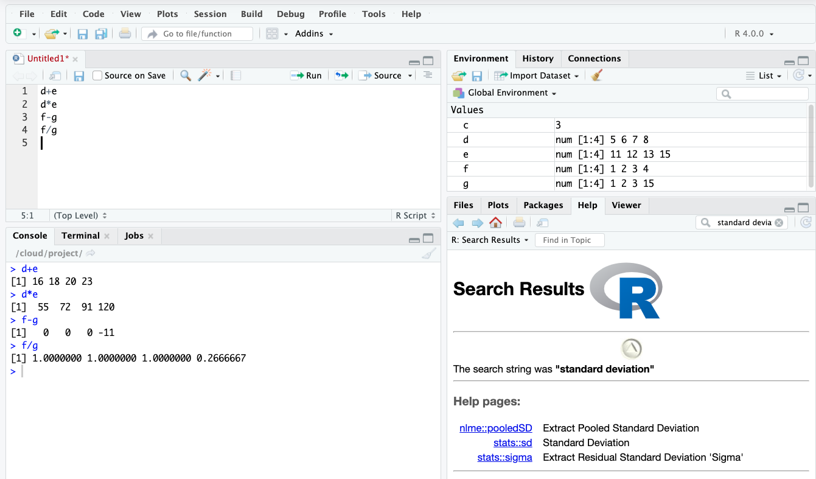

Slide 25
Combine Vectors
h <- c(d,e)
h <-rbind(d,e)
h <- cbind(d,e)

Slide 26
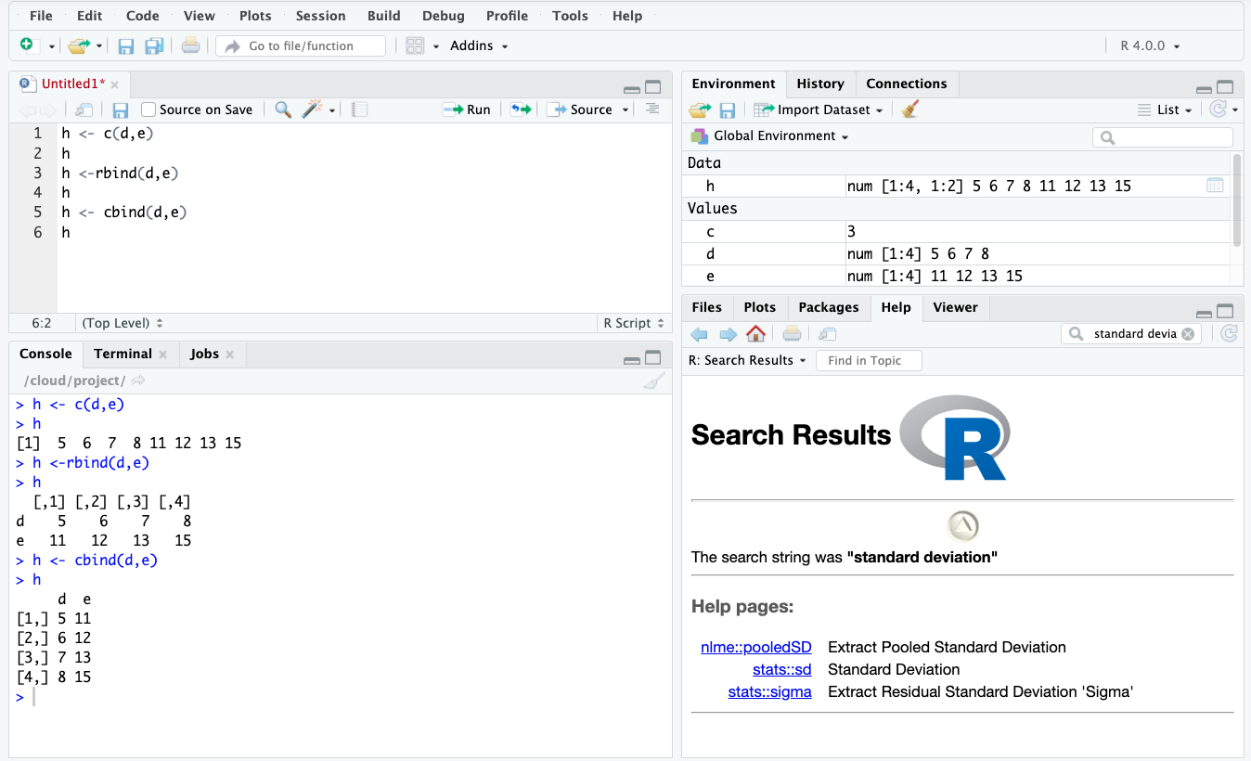

Slide 27
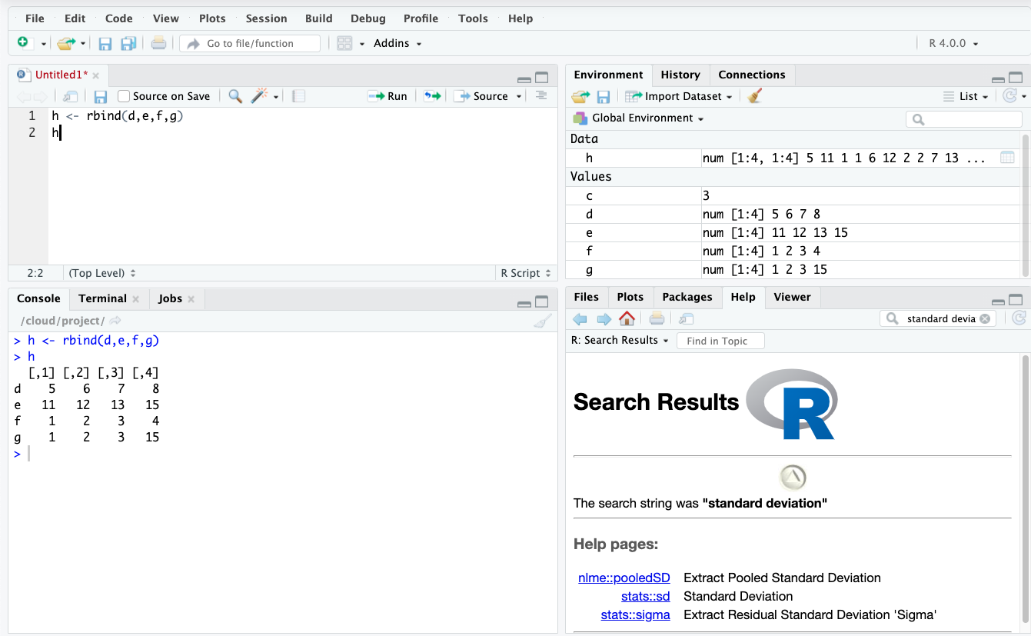
Let's Make a Data Table!
h <- rbind(d,e,f,g)

Slide 28
Column and Row Names
Independent of the data
Makes it easier to work with data later
colnames
rownames
Type the following:
colnames(h) <- c("Col1","Col2","Col3","Col4")
rownames(h) <- c("Row1","Row2","Row3","Row4")

Slide 29
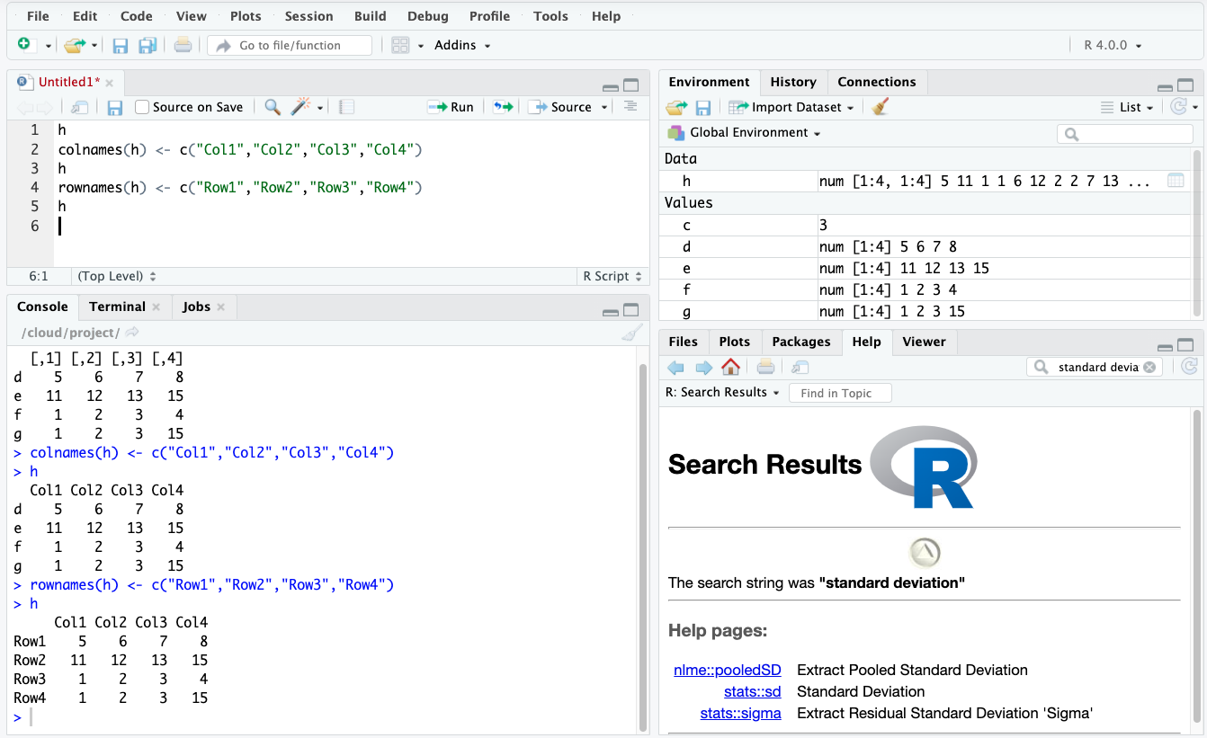

Slide 30
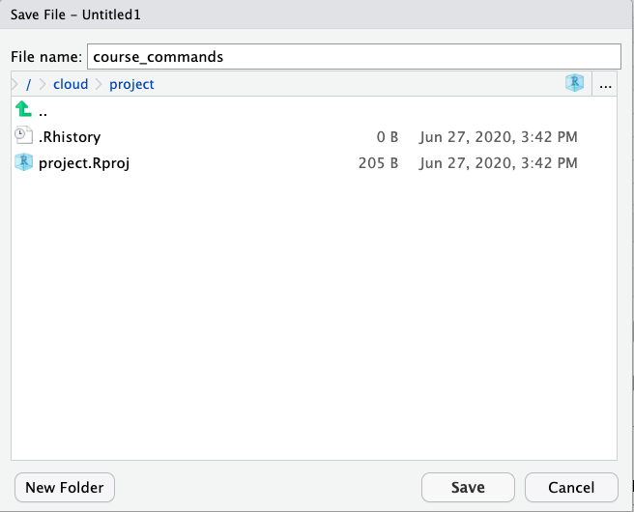
Save your amazing work!

Slide 31
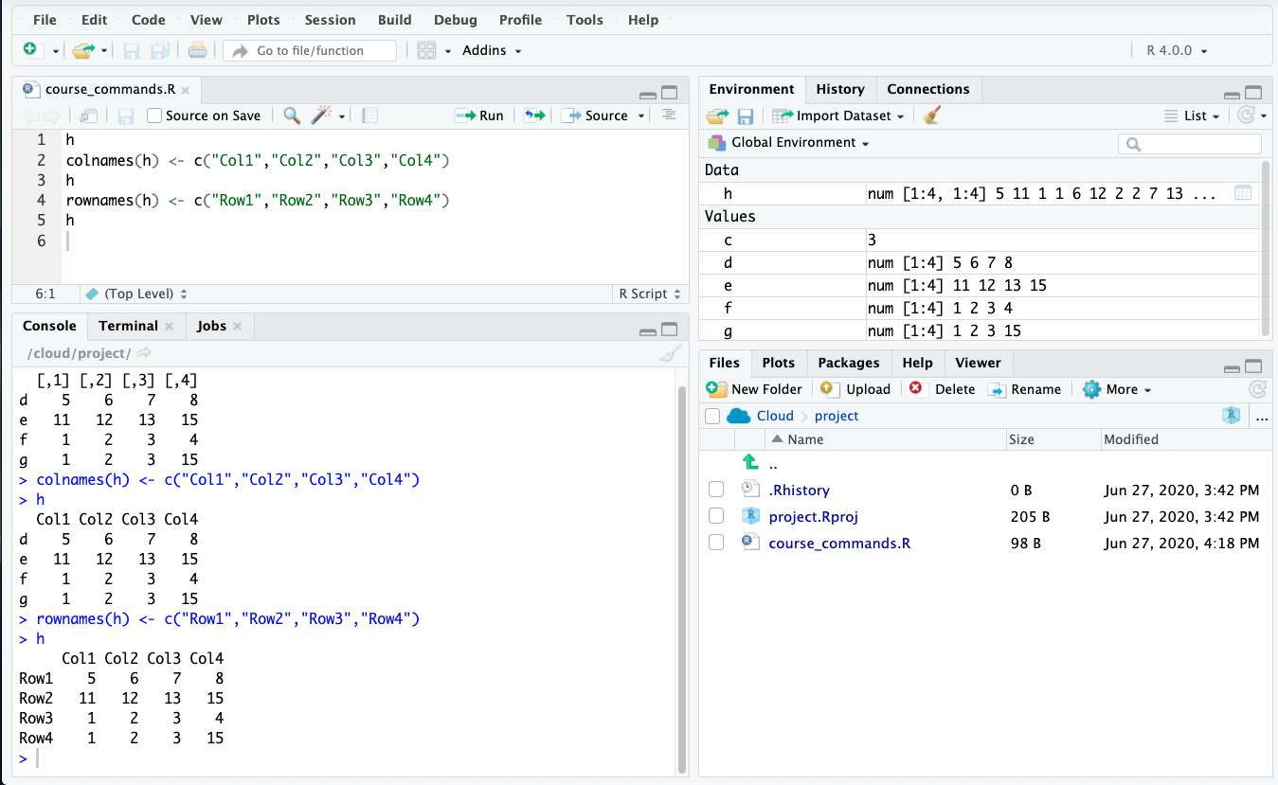

Slide 32
Activity 1: Basic_Commands.Rmd
We just practiced creating a R script to manipulate basic data.
Try running the Basic_Command.Rmd Notebook to reinforce your skills and learn about running R Markdown.
Please let me know if you run into any issues or have any questions.

Slide 33
Questions?
So far, we have:
Accessed R via R Studio or R Studio Cloud
Created a script
Done basic math operations
Created and used vectors
Done vector math
Created a data frame with named rows and cols
Run a markdown notebook reinforcing these concepts
Up next:
R Packages and Built-In Datasets

Slide 34
Packages and Built-in Datasets
Packages are add-ons to base R that increase functionality or ease of use
Datasets can be imported to or exported from R, however base R and some packages include built-in datasets
Built-in datasets are helpful for learning about datasets and testing functionality
Since they do not require complex import, they are ideal for many situations

Slide 35
What is a package?
A collection of R functions, complied code and data
Saved in a directory called “library”
Can be turned on and off
Made by different people commands may clash
Would also be very slow to load everything every time

Slide 36
Survival Package
https://cran.r-project.org/web/packages/survival/index.html
PBC Dataset
Has a built-in dataset called PBC which is the Mayo Clinic Primary Biliary Cholangitis Data
We will have to download and load the package to use this dataset

Slide 37
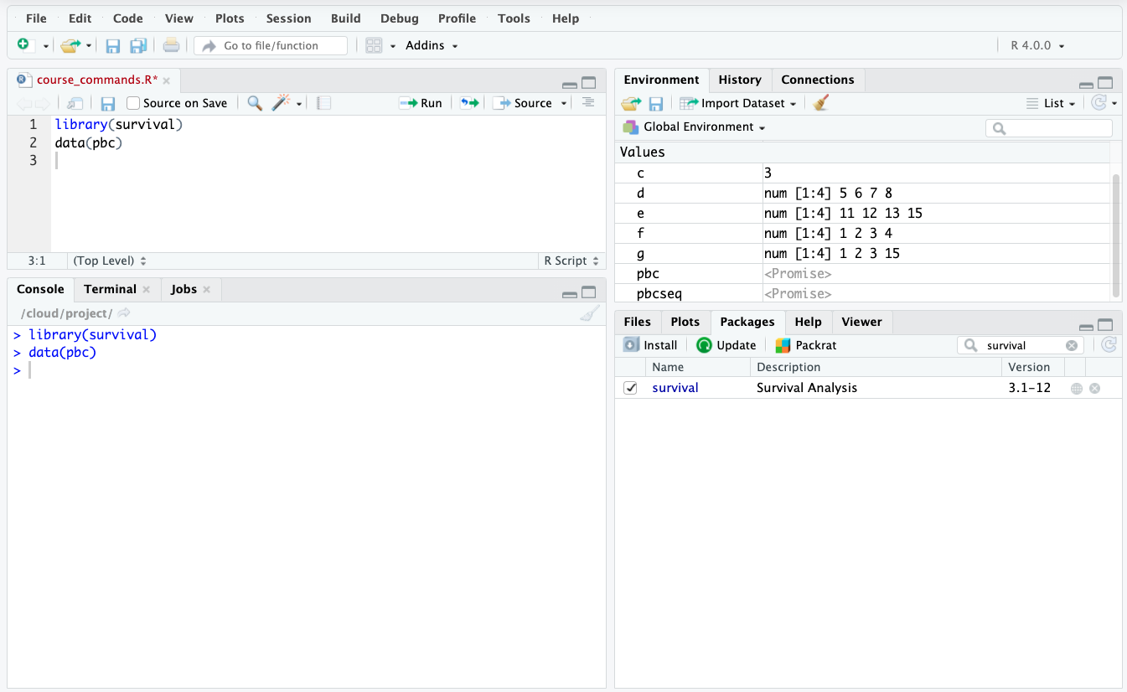
Notes:
Either command line or click on packages

Slide 38
Activity 2: Packages and Built-in Datasets
Click on the Packages_and_Datasets.Rmd file
This file explores working with built-in datasets and importing packages
We will work with two datasets
Iris
Base R dataset
PBC
Found within the survival package

Slide 39
Data Manipulation
We could use base R
Or the tidyverse collection of packages
Specifically designed for data science

Slide 40
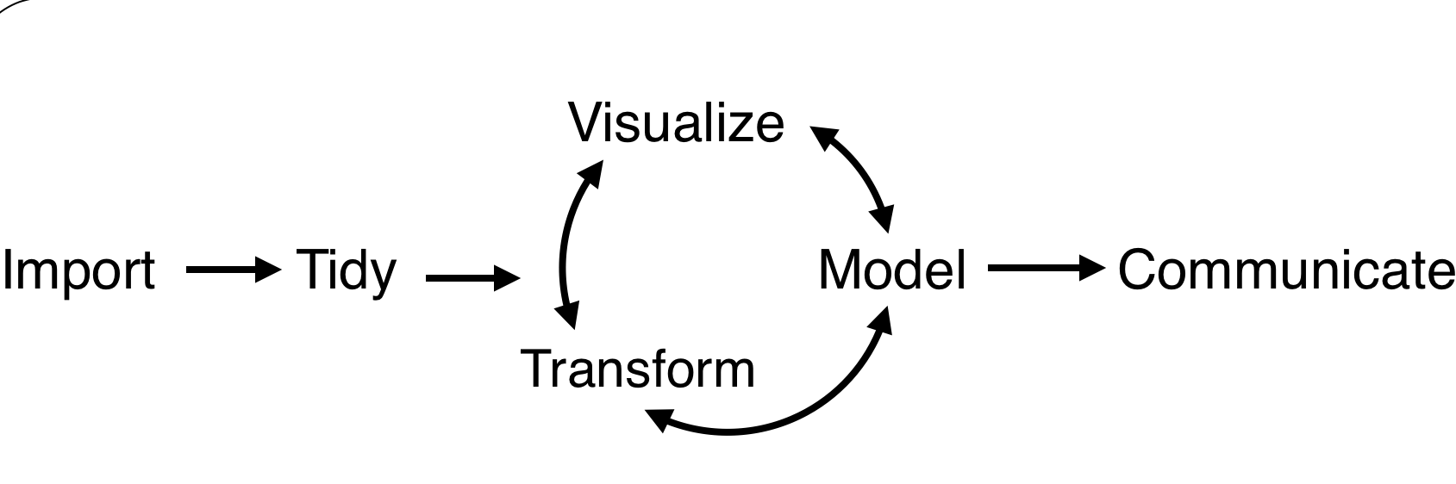


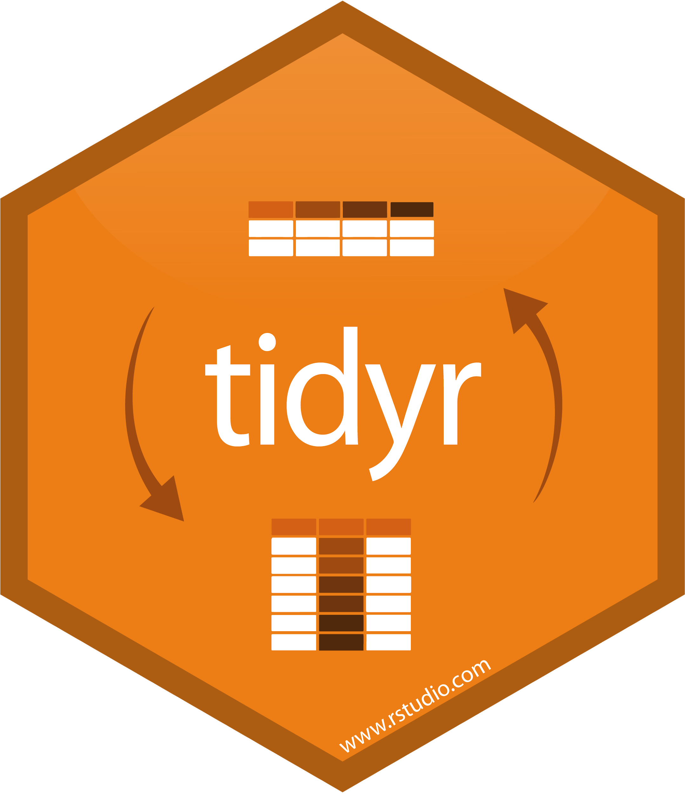






Tidyverse
First time install: install.packages("tidyverse")
Turn on package set: library(tidyverse)

Slide 41
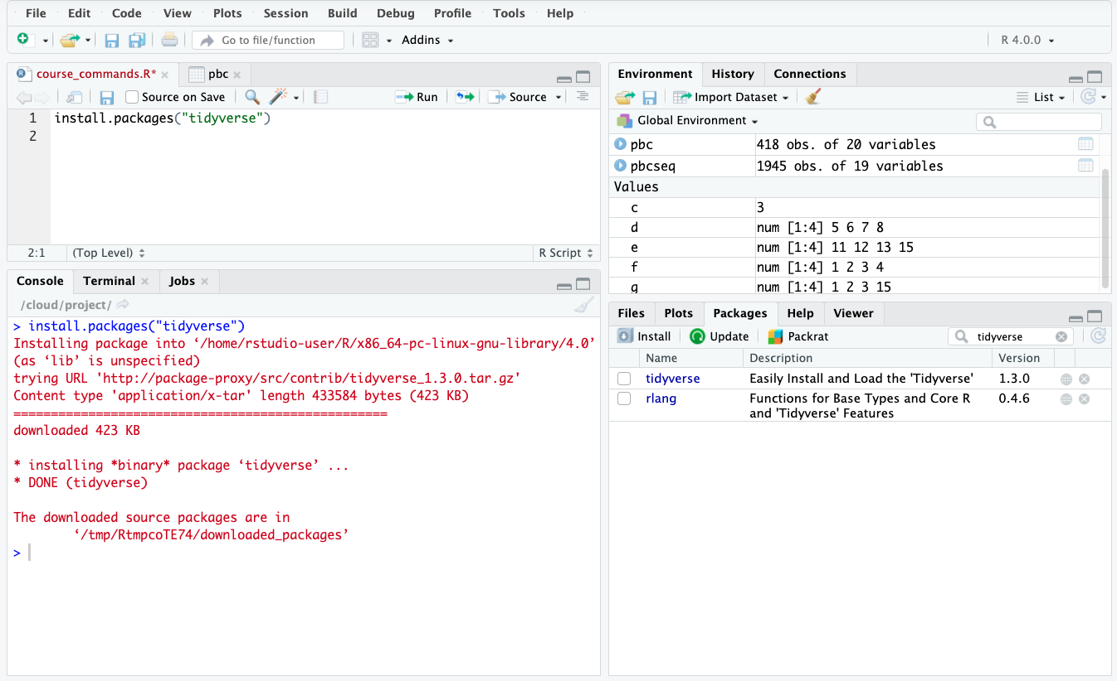
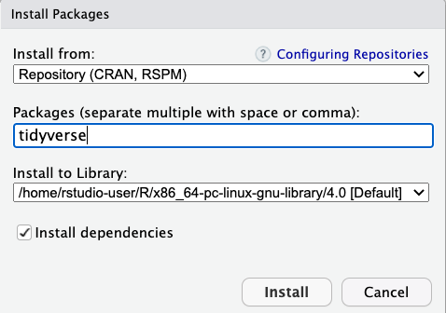
Install like this
Or like this

Slide 42
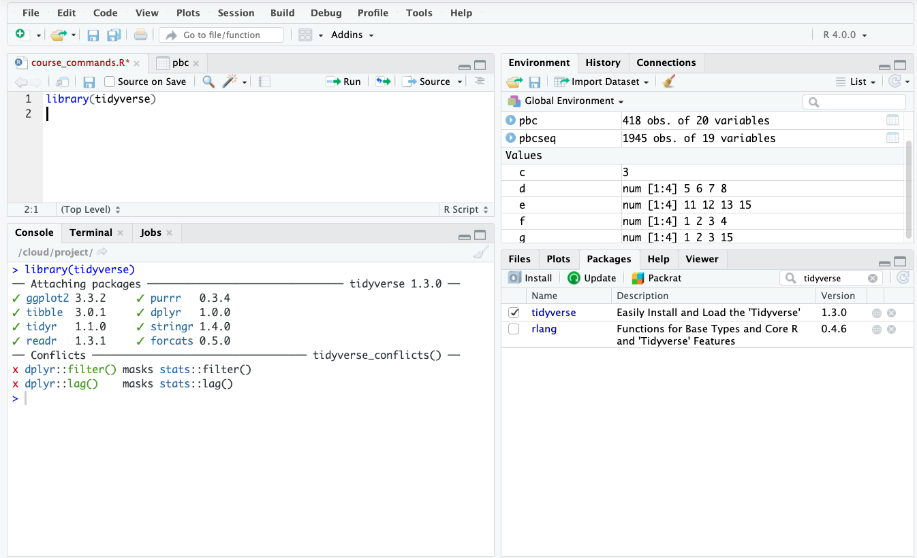
This
OR this
Notes:
install.packages("devtools")
devtools::install_github("tidyverse/tidyverse")

Slide 43
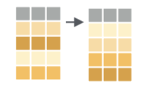
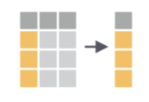
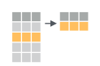
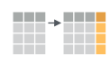
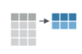
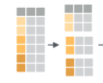
dplyr: Transform your data
arrange()
select()
filter()
mutate()
group_by()
summarize()
Basic structure:
dpylr function(data, specifics)
Example:
arrange(pbc, age)
Notes:
pbc %>%
select(sort(names(.)))
pbc <- pbc %>% mutate(
age_bin = case_when(
age <= 45 ~ "Adult",
age >45 & age <= 60 ~ "Middle_aged",
age >60 ~ "Old"))
We can also use .after=age

Slide 44
Pipes!
Let’s say I want to know the average age for males versus females I could:
group_by_sex <- group_by(pbc,sex)
ave_age_sex <-summarize(group_by_sex, mean = mean(age))
OR.
Use a pipe! %>%
This allows sequential operations to be done on the same dataset:
pbc_final <- pbc %>% group_by(sex) %>% summarize(new_col = mean(age))
View(pbc_final)
Keyboard Shortcut:
PC:Ctrl+Shift+M
Mac:Cmd+Shift+M
Notes:
summarise()` ungrouping output (override with `.groups` argument) This is just to tell you the data fed into the summary was grouped

Slide 45
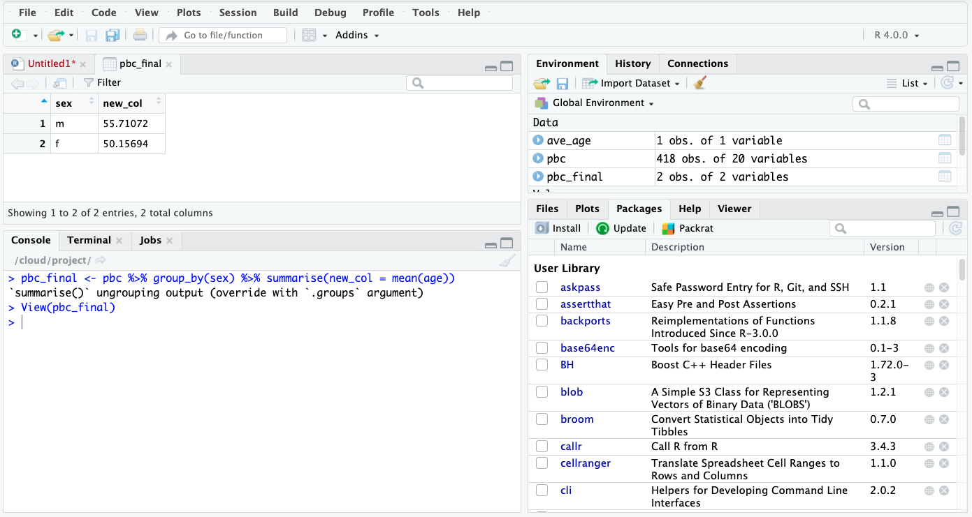
Notes:
summarise()` ungrouping output (override with `.groups` argument) This is just to tell you the data fed into the summary was grouped

Slide 46
Activity 3: Data Manipulation
Using the pre-made R Notebook Data_Manipulation.Rmd we will explore the following data manipulations:
Arrange
Select
Filter
Mutate
Summarize
GroupBy

Slide 47
Questions?
What data manipulation options are available?
Which operation would you use to create a new column of data?
Which two options are available for arranging data?
What symbol is used to join multiple commands?
Notes:
1. Arrange, select, filter, mutate, summarize, groupby
2. Mutate
3. Ascending, descending
4. The `pipe` command

Slide 48
Data Import and Export
Data comes in many formats
There are a variety of tools for importing and exporting data
R can handle data in csv, tab-delimited, excel formats and more

Slide 49
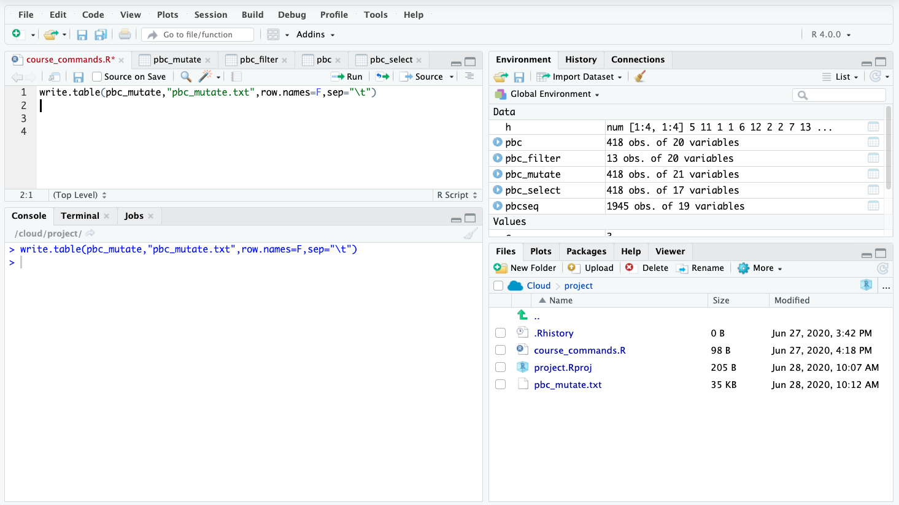
Save a table as a file
write.table(pbc_mutate,"pbc_mutate.txt",row.names=F,sep="\t")

Slide 50
Read Data From Website
read_csv() and read_tsv() are special cases of the more general read_delim(). They're useful for reading the most common types of flat file data, comma separated values and tab separated values, respectively.
File can be a url where data is stored
Run `?read_tsv` for more help information

Slide 51
Activity 4: Data Import and Export
Using the pre-made R Notebook Data_Import_and_Export.Rmd we will explore the following:
Save as tab delimited text
Save as a csv file
Load both tab delimited and csv files
Load data from a url

Slide 52
Visualizations for Today
Bar plot
Histogram
Density Plot
Scatter plot
Faceted plots (multiple plots in the same figure)

Slide 53
ggplot2: Visualize your data
Easy out of box formatting
Handles complex data quickly
Default options are aesthetically pleasing
Layering system = add complexity as you go
Automatic scaling generally works well
Great documentation and support

Slide 54
ggplot2: Visualize your data
What you need:
1. A data object
2. Aesthetic mappings (aes): how variables in the data are assigned to visual properties
x- and y-direction
shapes, colors, lines
3. A geometry object (geom): the type of plot
Basic structure:
ggplot(data, aes(x=variable)) + geom_type()
Example:
ggplot(pbc, aes(x=sex)) + geom_bar()

Slide 55
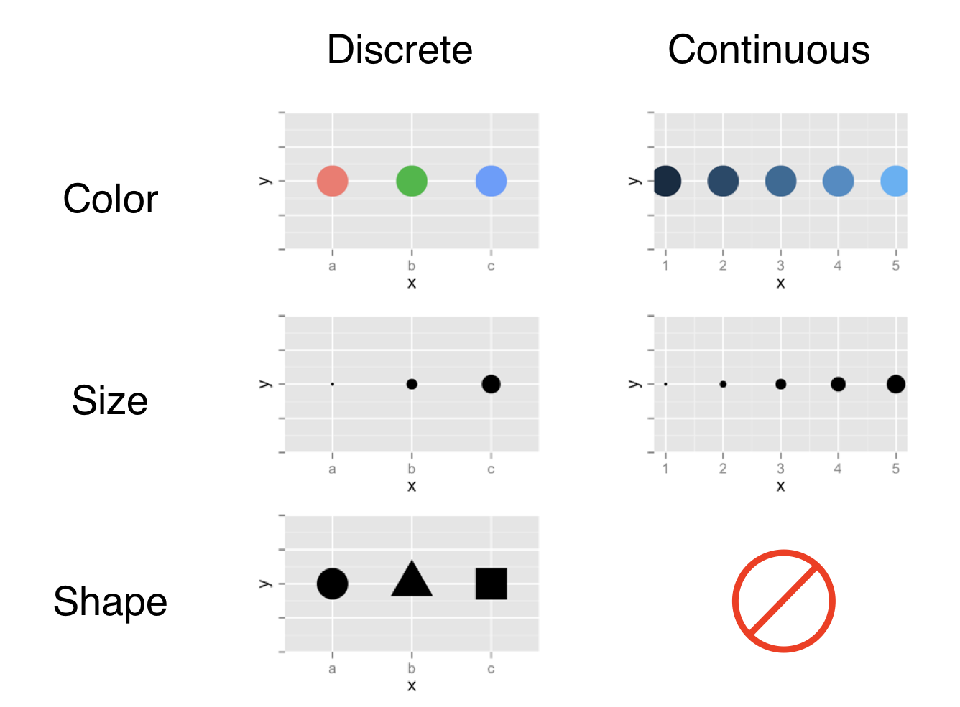
Aesthetic mapping options

Slide 56
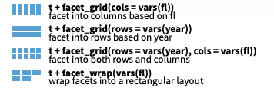

ggplot2:Faceting
Divide a plot into subplots based on one or more discrete variable
Can be used with a variety of plot types
There are a couple of facet flavors
We will use facet wrap

Slide 57
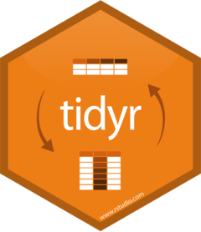
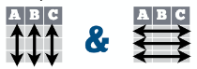
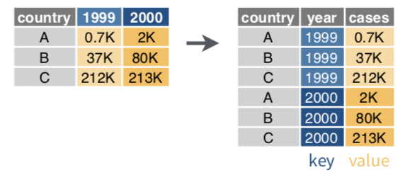
tidr:gather
Typically, each variable is in its own column and each observation/case is its own row
Transform data from wide to long format
gather(data, key, value)
Moves column names into a key column, gathering the column values into a single value column
Notes:
Have note on opposite of gather

Slide 58
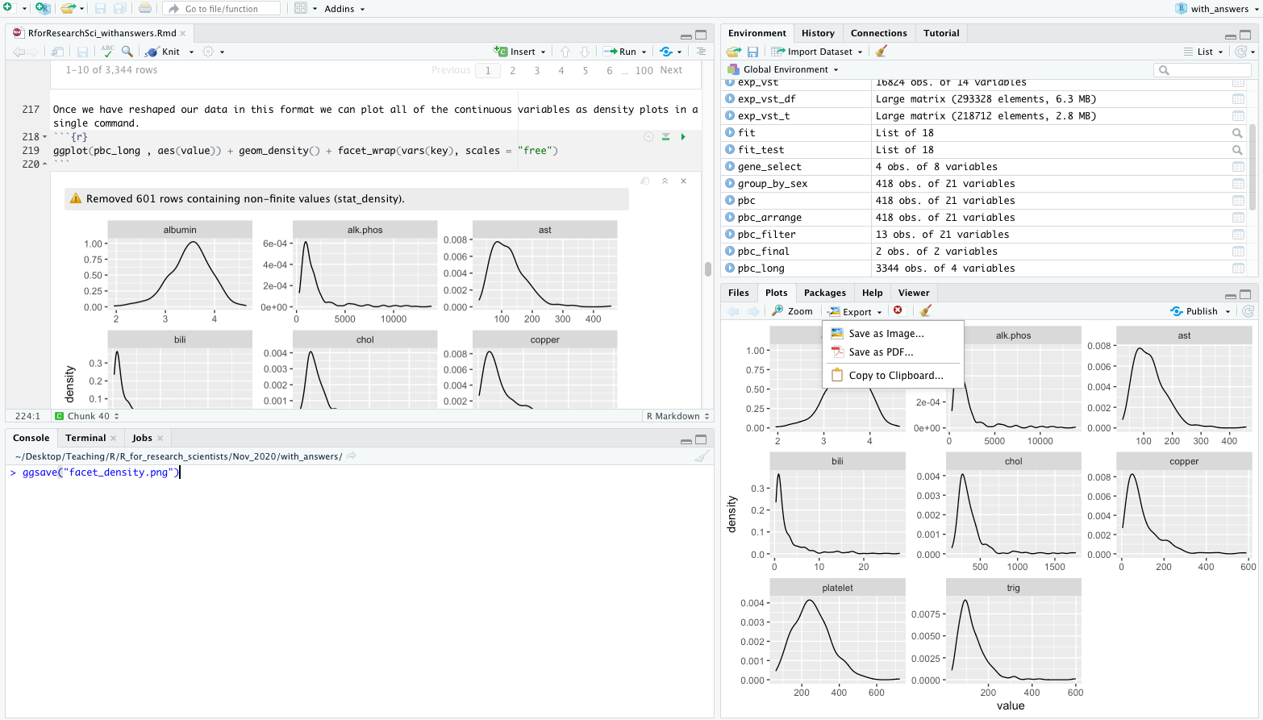
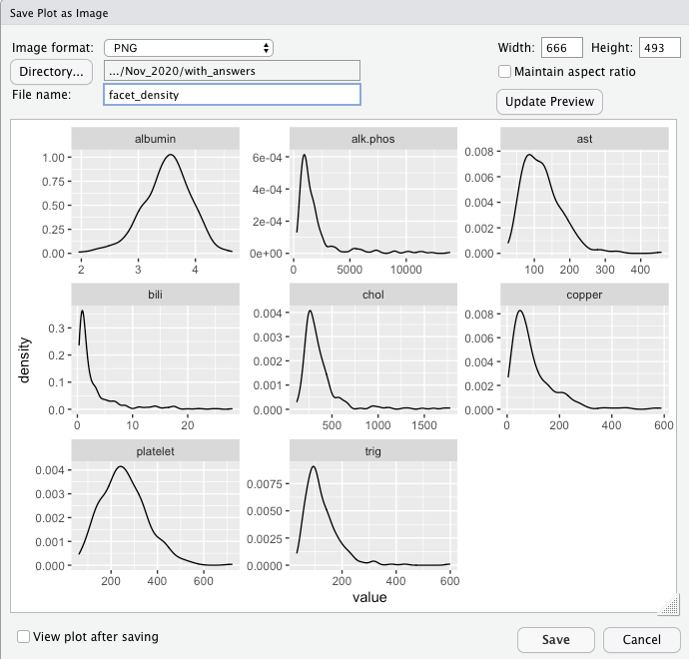
Saving your beautiful graph!
ggsave(“facet_density.png")
OR SEE BELOW!

Slide 59
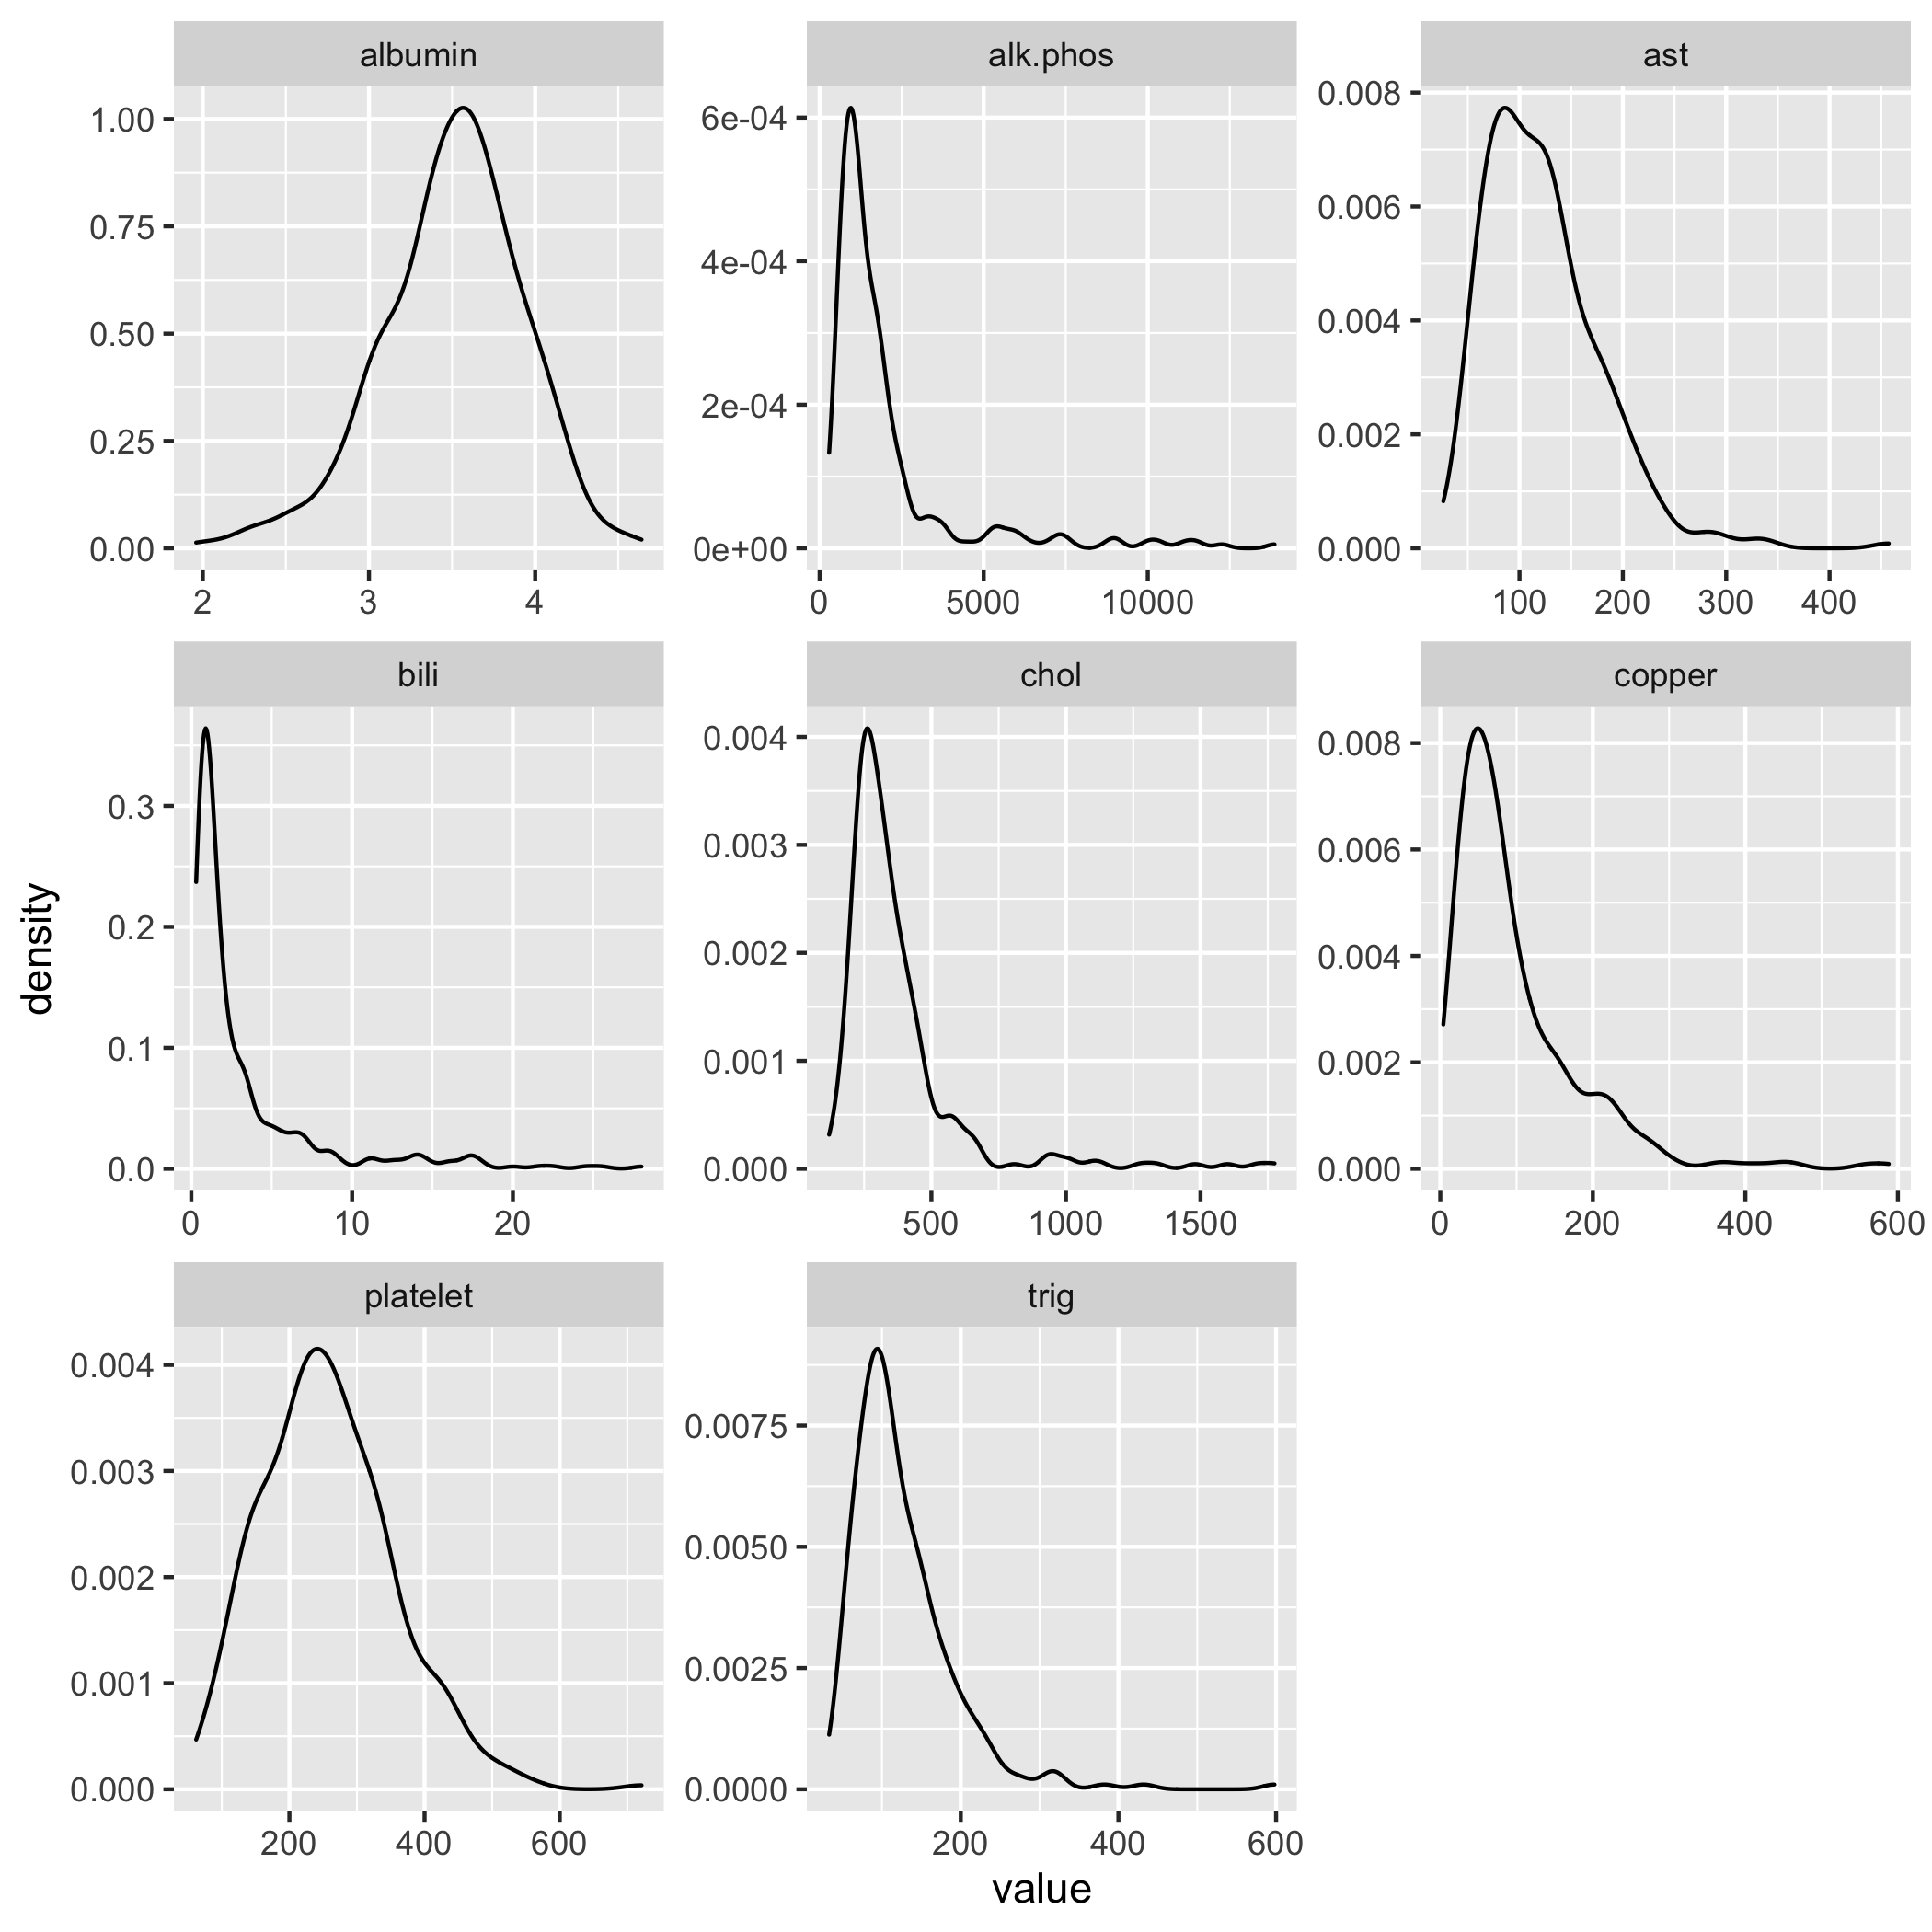
Questions on Basic Visualizations

Slide 60
Activity 5: Data Visualization
Open the notebook Data_Visualization.Rmd
Explore plotting and data visualizations

Slide 61
Data Analysis in R
Correlations
Pearson
t-tests
Single sample
Independent
Paired

Slide 62
Correlation
Measure of how well two variables hang together
Range from 1 to -1
1 is a perfect positive correlation
-1 is an inverse correlation

Slide 63
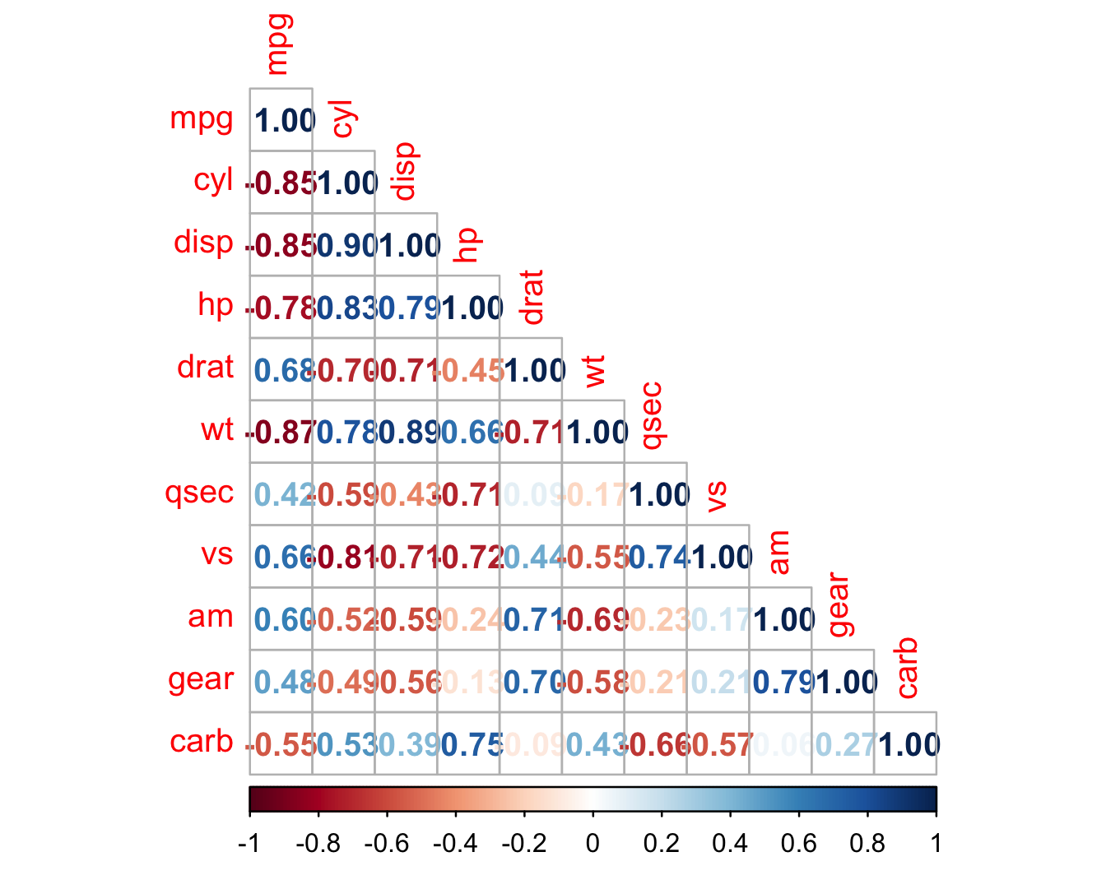
Correlation
Diagonal is all 1’s
Positive and negative correlations are color coded
Strength is shown in darker colors

Slide 64
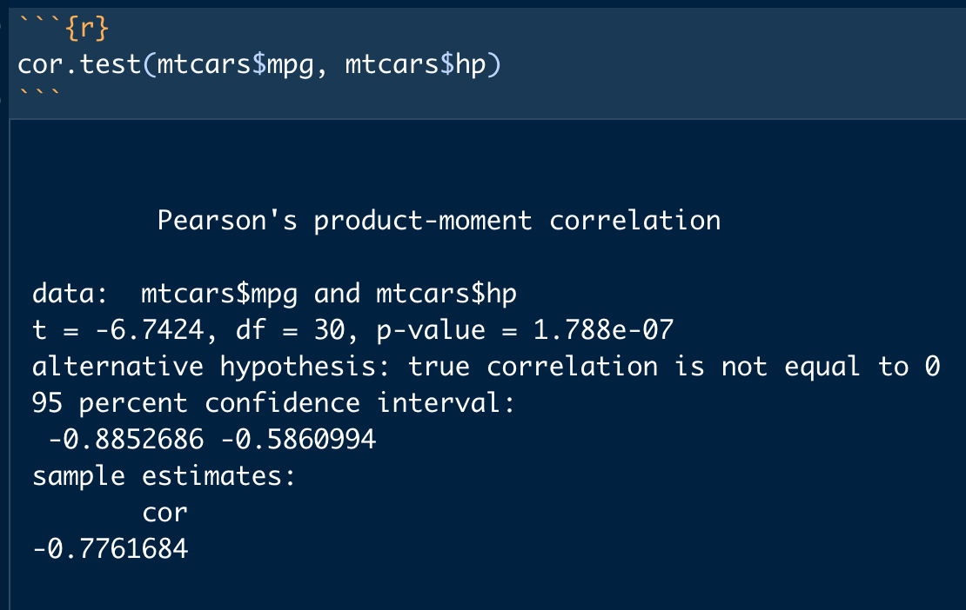
Correlation Test
Cor.test
P-value shows significance
Correlation coefficient is shown at bottom

Slide 65
t-tests
Single sample
Compares a sample to a known value (mu)
Independent
Compares two samples which are not related
Paired
Compares two samples which are related

Slide 66
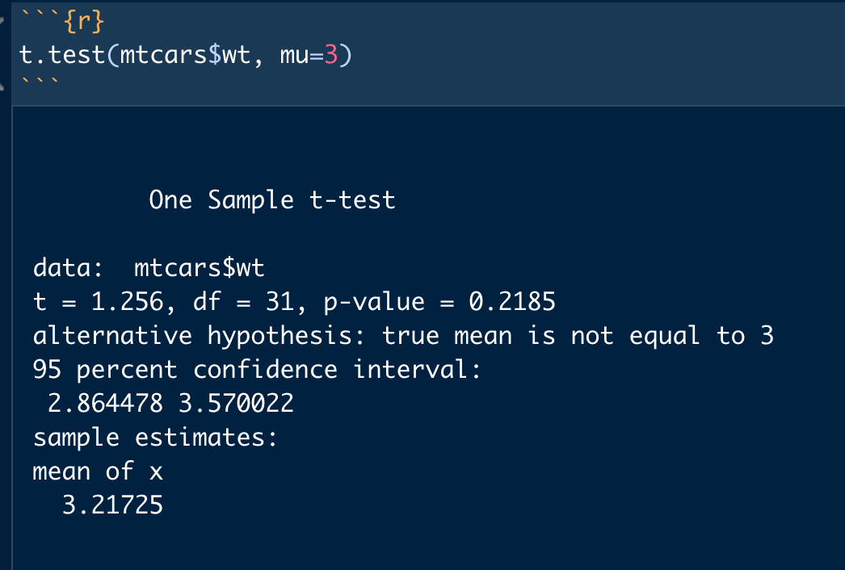
One Sample t-test
Compares a vector of data against a know value (mu)
p-value indicates significance
Mean of vector is shown at bottom

Slide 67
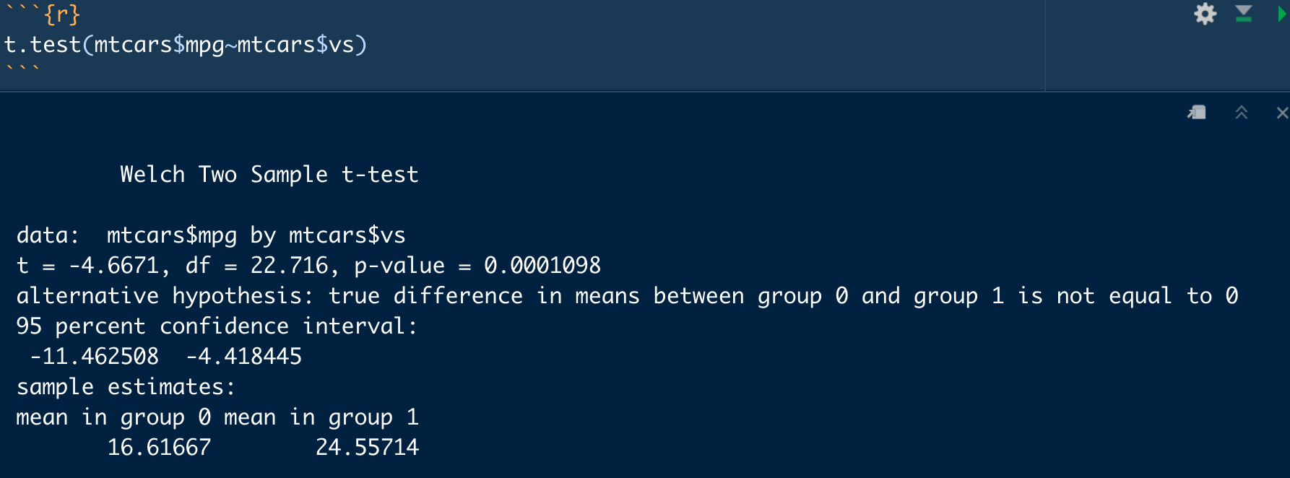
Two Sample Independent t-test
Compares two vectors of numeric data
Determines if means are different
p-value indicates significance
Means of each group displayed at bottom

Slide 68
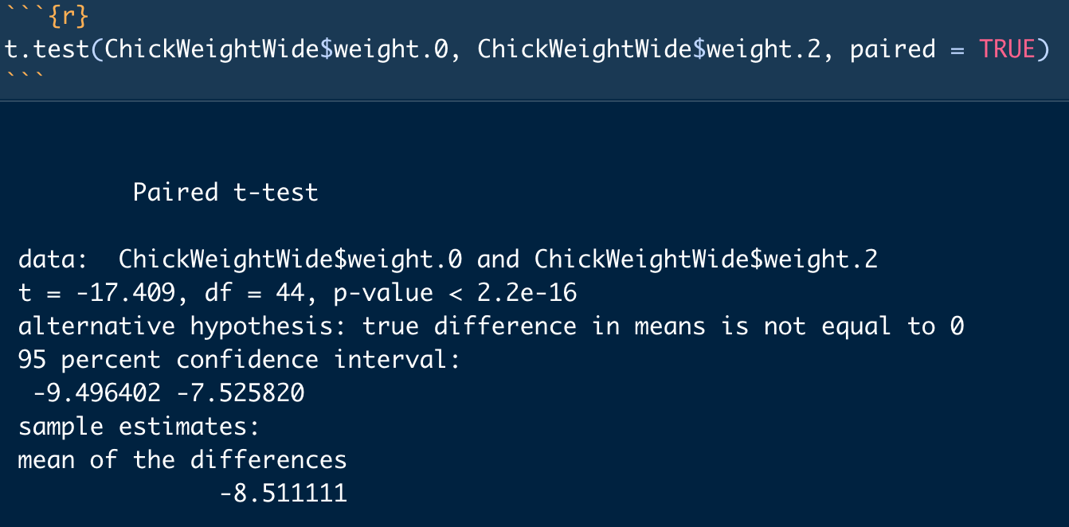
Paired-Samples t-test
Compares two related samples
P-value indicates significance
Average of the differences is shown at the bottom

Slide 69
Activity 6: Data Analysis in R
Open the notebook Data_Analysis.Rmd
Basic analysis techniques in R
Correlations
t-tests

Slide 70
This concludes the Intro to R
Additional materials and examples can be found in the supplemental topics folder of this repository.

